Slide 1
Vidatis
Automated audiovisual media validation

Slide 2
Mission Statement
Create technology that provides insight into the authenticity and origin of audiovisual media.

Slide 3
How Did we get here?
Had an idea
Began researching to find out plausibility
Found some academic research supporting various aspects of the idea, but no evidence that the various components had been put together as a whole and broad capability established.
Contacted some lifelong friends
Expertise in the field of computer vision, audiovisual analysis, and scalable app development.
Completed the team with additional coding expertise
Worked for the last year
develop current capability and complete initial patent filing.

Slide 4
The Team: Jason Harvey
Founder of Vidatis
Texas A&M University
Over 25 years of experience in business leading enterprise level projects and transformation initiatives
SVP of Strategic Business Process Improvement at Santander Consumer USA
Almost 20 years at Ford Motor Credit Company in a wide variety of Finance and Internal Consulting roles
Experience in small start-up environments all the way through large multi-national banks.
Expert in business operations, process management, and project management

Slide 5
The Team: Dr. Karl Schwerdt
Cofounder of Vidatis and world class computer vision expert
Phd in computer vision in France from the National Institute for Research in Digital Science and Technology (in 2001), and his M.S. from Texas A&M University in 1996
Since 2001 Karl has been working as a professional engineer in a variety of roles ranging from previous Start-up Founder, researcher, and management consultant
Worked for over 20 clients as a freelance engineer with projects including the creation of an intelligent video surveillance system with integrated scene analysis for the French DGA (equiv. to DARPA)
Expertise in the creation and optimization of 2D and 3D visual analysis algorithms for robotics, automotive radar systems, and software control applications

Slide 6
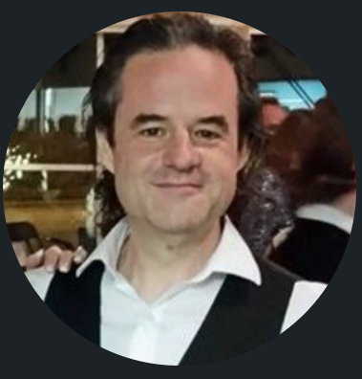
The Team: Chris Behrens
Cofounder of Vidatis and an accomplished software developer, technologist, and software architect with more than 25 years of experience
Developed applications and delivery systems for Fortune 50 companies and his systems have processed hundreds of millions of dollars in revenue
Created a wellness program application for a healthcare provider company (which was the largest private employer in the US at the time)
Developed automated testing and deployment systems for dozens of companies
Author of more than 50 online training programs in topics ranging from getting along with difficult people at work, to Agile management, to automated deployments

Slide 7
The Team: Michael Jarrett
Cofounder of Vidatis
Graduated from UT Austin with an honors computer science and math degree
Deep understanding of computer systems, and broad experience in industry
Implementing customer specifications, building robust data pipelines, and bulletproofing critical database infrastructure for Stripe
Developing and maintaining low-level infrastructure powering Jane Street

Slide 8
The problem
The world is awash in digital Media
With no way to know what’s real
And with no one to trust
Notes:
https://rarehistoricalphotos.com/stalin-photo-manipulation-1922-1953/

Slide 9
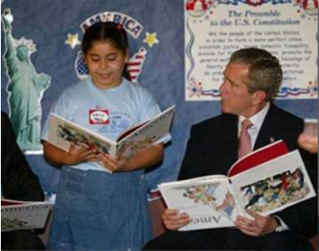
The Problem
Ongoing massive increases in digital media manipulation with increasingly sophisticated tools capable of producing results that fool human perception

Slide 10
Plan to address the problem
Break It Down
Segment the issues:
Photographs
Video
Audio
Focus Effort
Focus on the photograph segmentation
Develop transferable capability
Create delivery infrastructure and establish customer base.

Slide 11
The Solution
Developed a Patent Pending process that allows us to identify altered photographs without the use of a reference image.

Slide 12
The solution - How
Statistically analyze image data
Patterns that emerge from the behavior of light in the image
Natural Law Mathematical model
Created mathematical model of the expected natural behavior of light in the image
Analysis of the deviation
Images that have been altered from a natural state tend to have predictable patterns which emerge in the deviation from our natural light behavioral model

Slide 13
The solution - How
Value Parameter

Slide 14
The solution - How
Run for each parameter value

Slide 15
Examples- Unedited

Slide 16
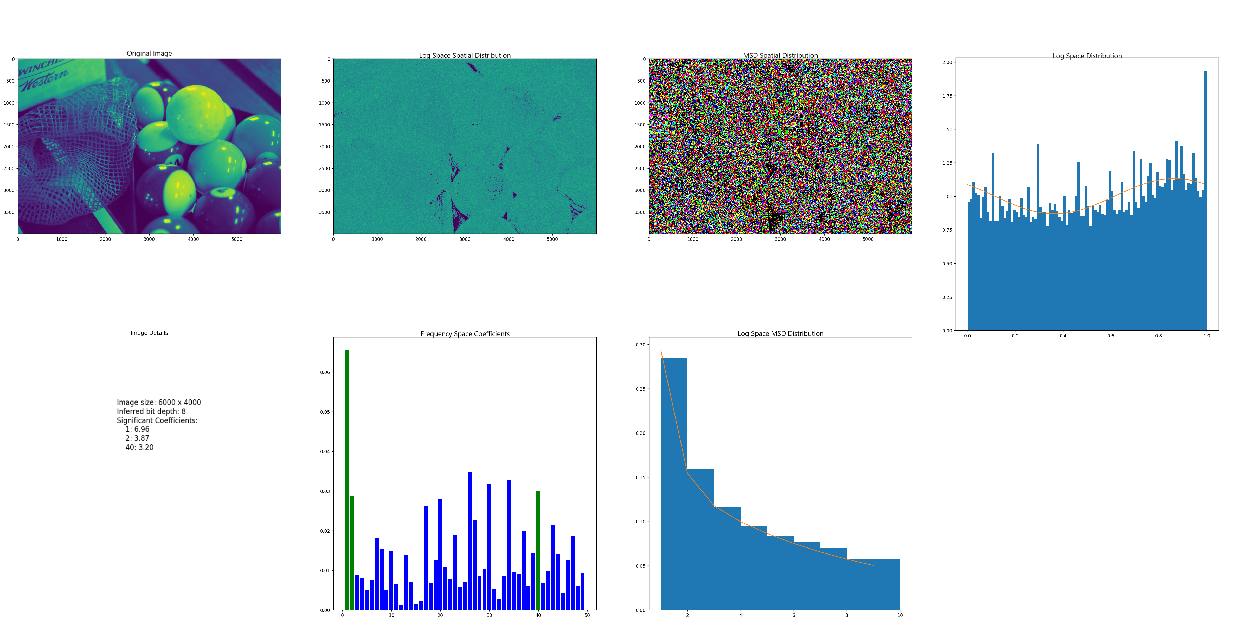
Examples- Unedited
We look for a sinusoidal distribution in the Log Space Distribution chart
The extent of the sinusoidal distribution can be seen in the prominence of the 1hz position and the reduced values in the following positions

Slide 17
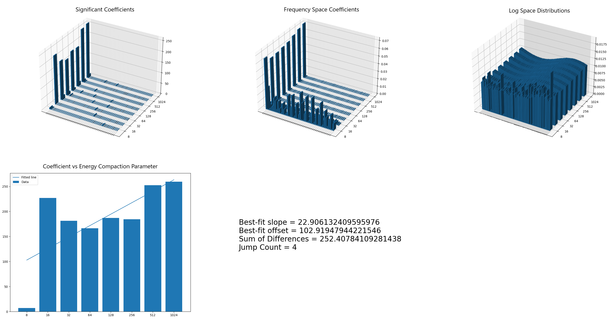
Examples- Unedited
We look for mostly flat values across the multiple Coefficient vs Energy Compaction Parameter values

Slide 18
Examples- Edited

Slide 19
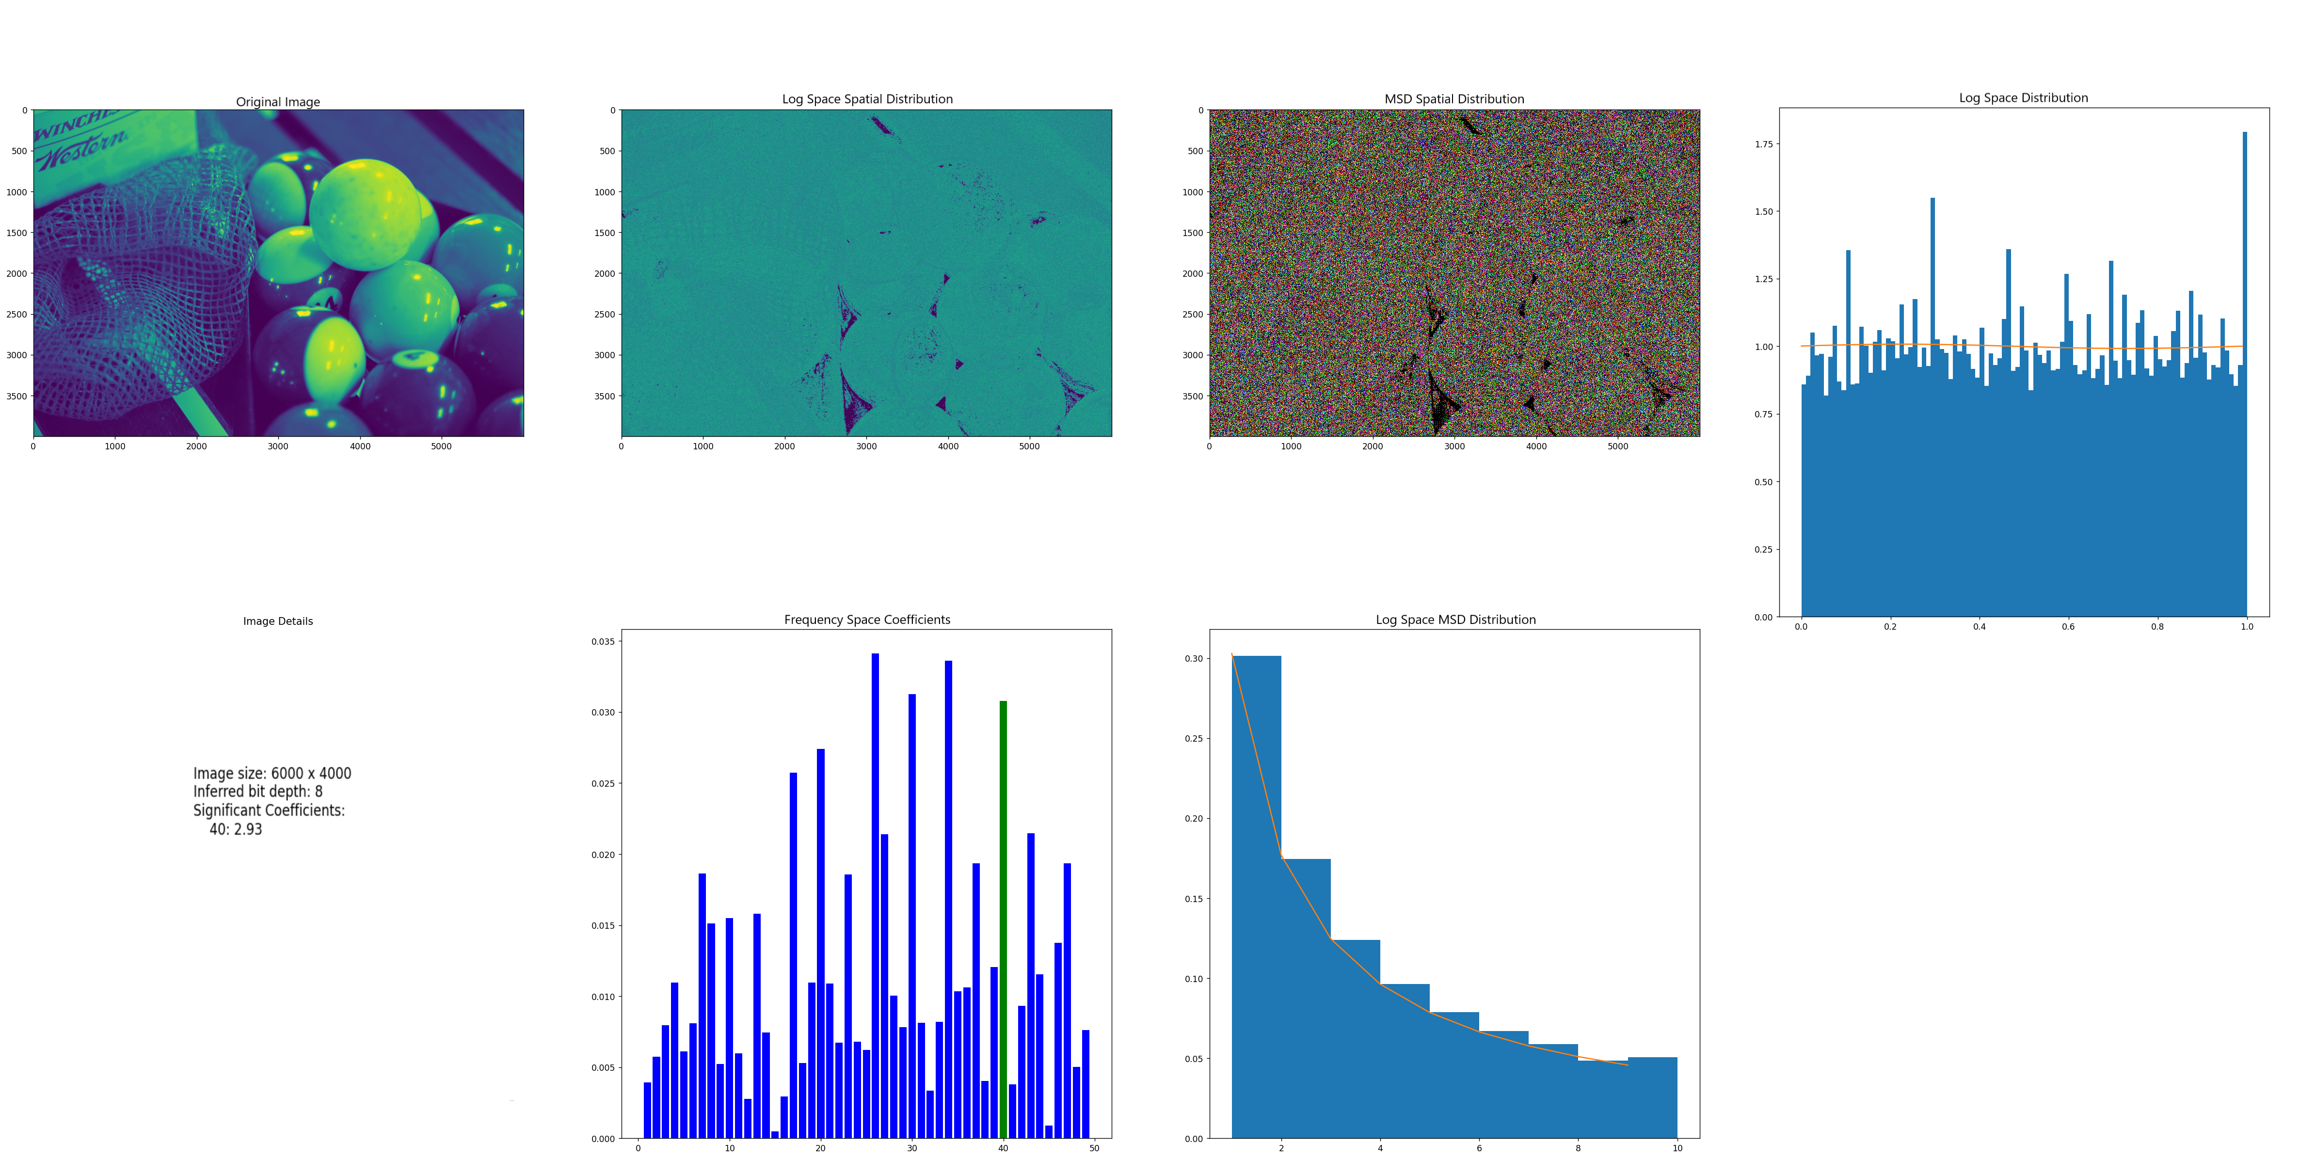
Examples- Edited
Lack of sinusoidality in the Log Space Distribution
Reduced significance of the 1hz position and increased significance of the following positions

Slide 20
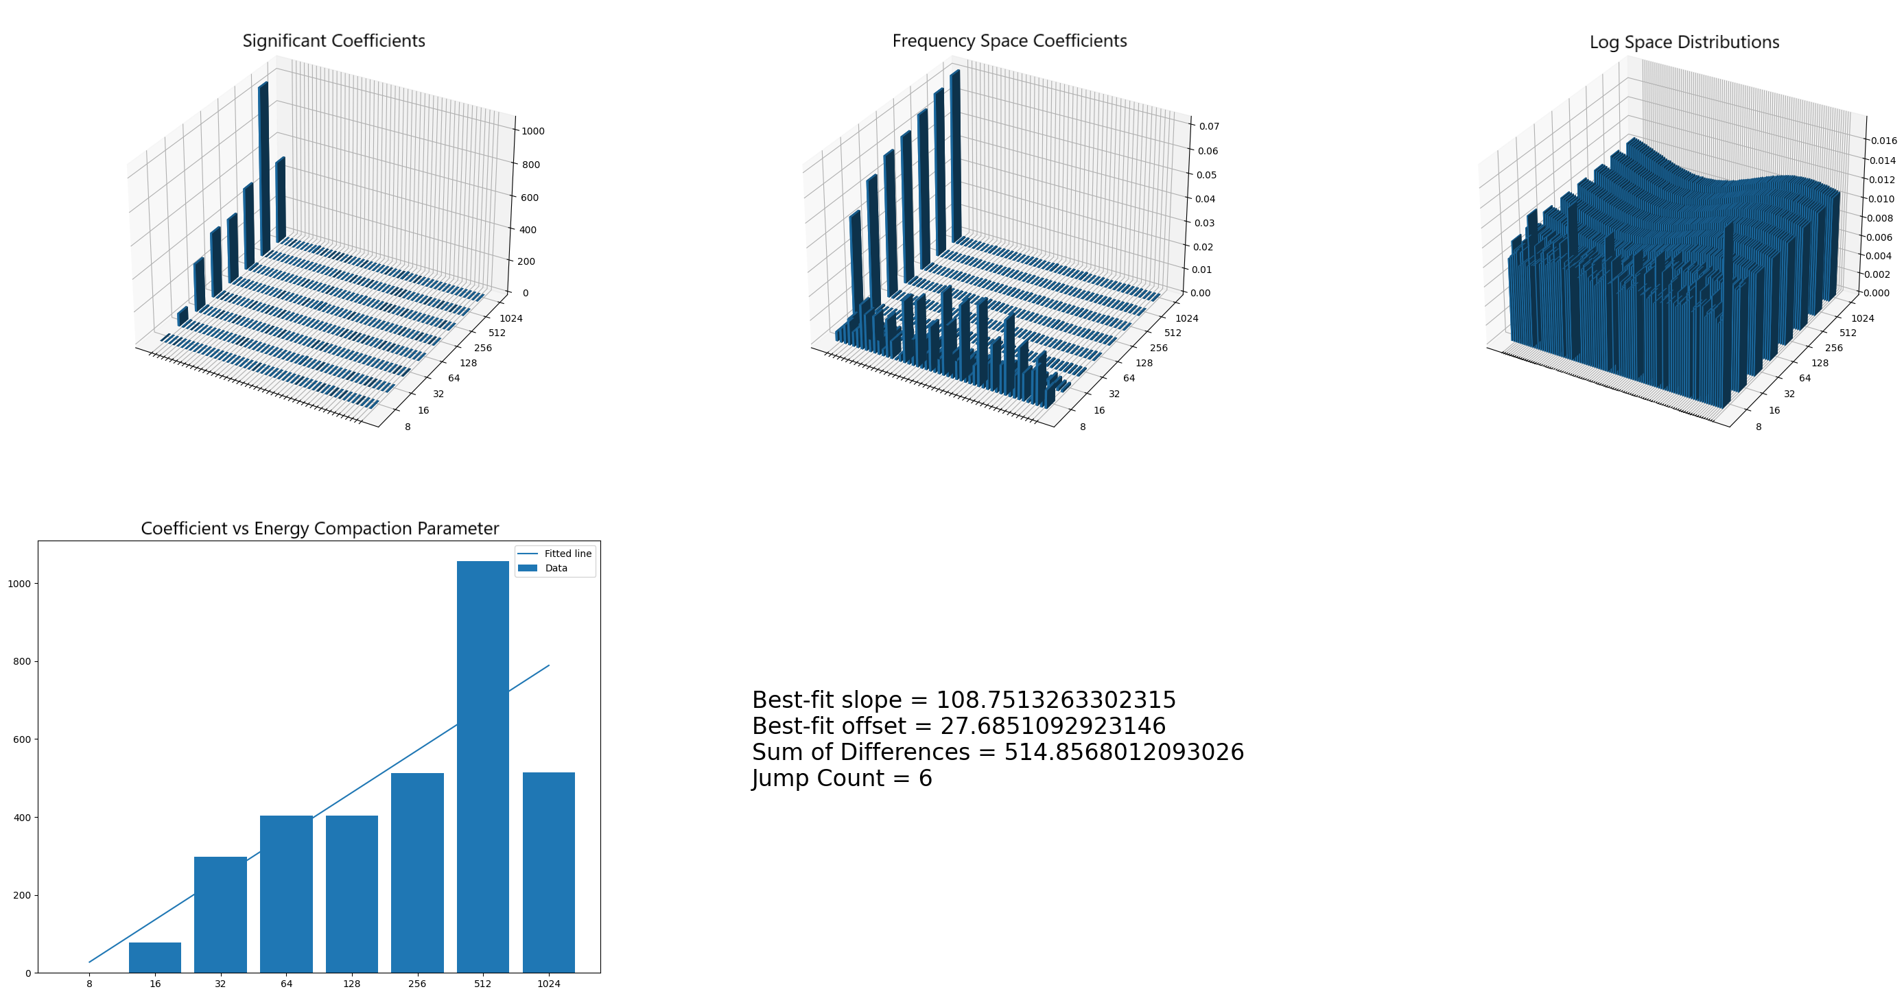
Examples- Edited
Strong positive slope observed across the Coefficient vs Energy Compaction Parameters

Slide 21
Examples
Unedited Original
Edited

Slide 22
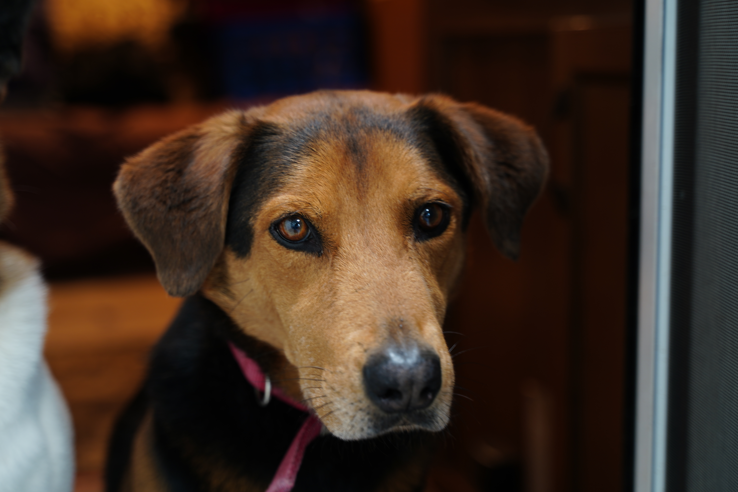
Examples- Unedited

Slide 23
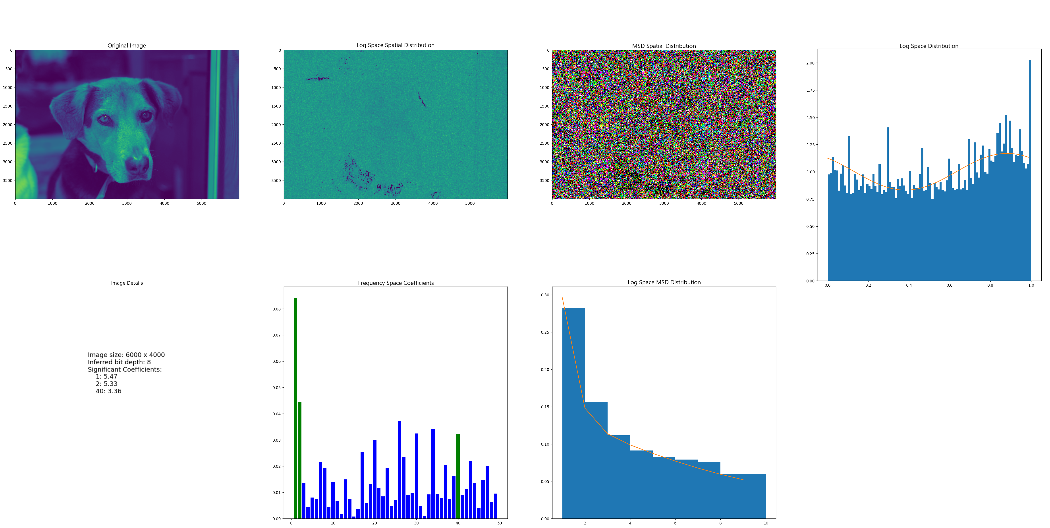
Examples- Unedited

Slide 24
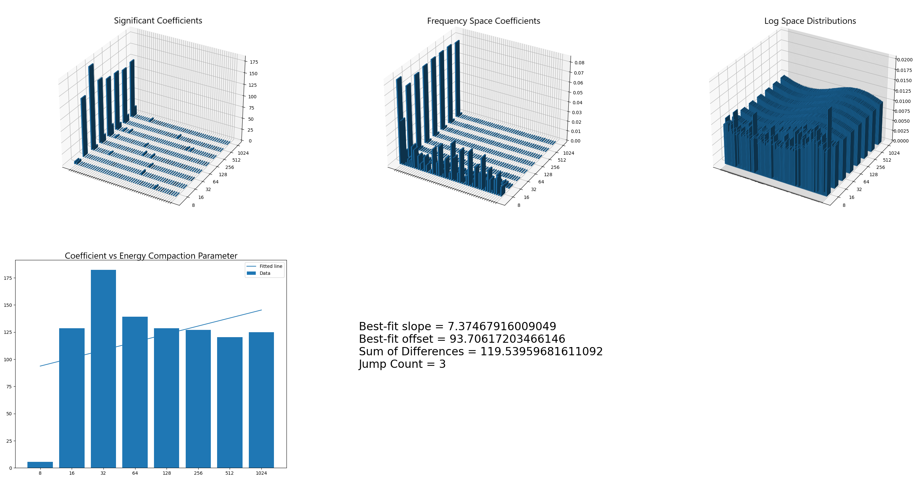
Examples- Unedited

Slide 25
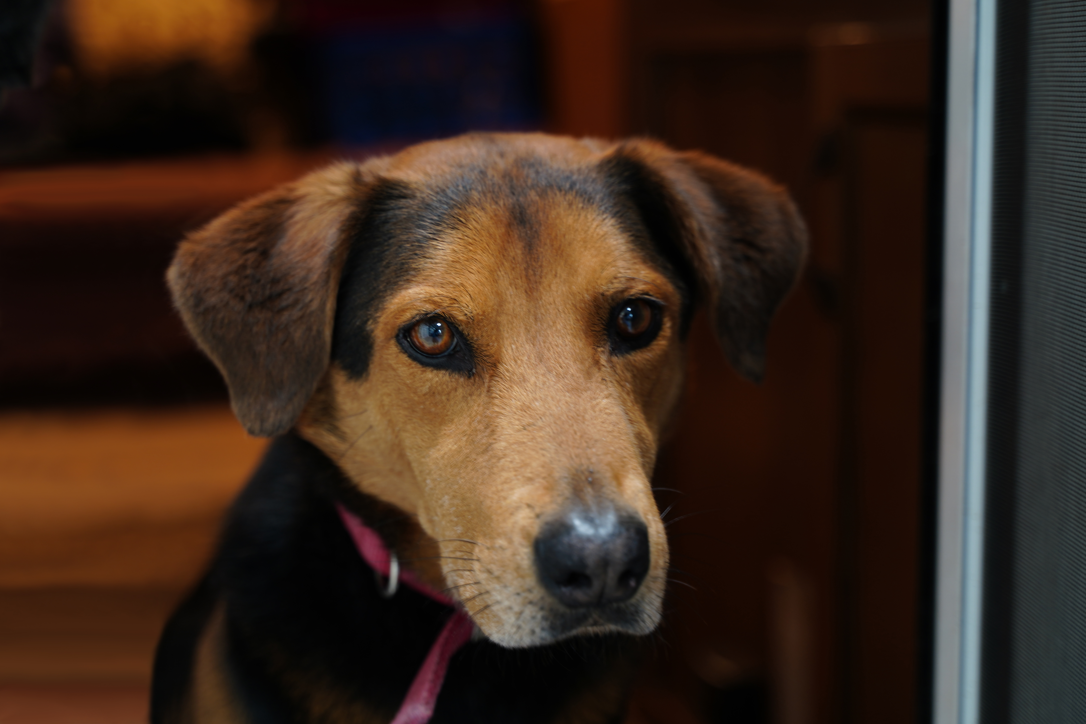
Examples- Edited

Slide 26
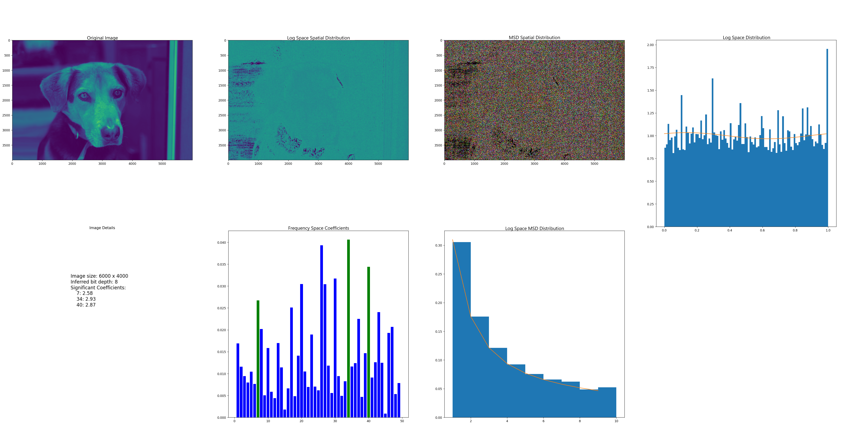
Examples- Edited

Slide 27
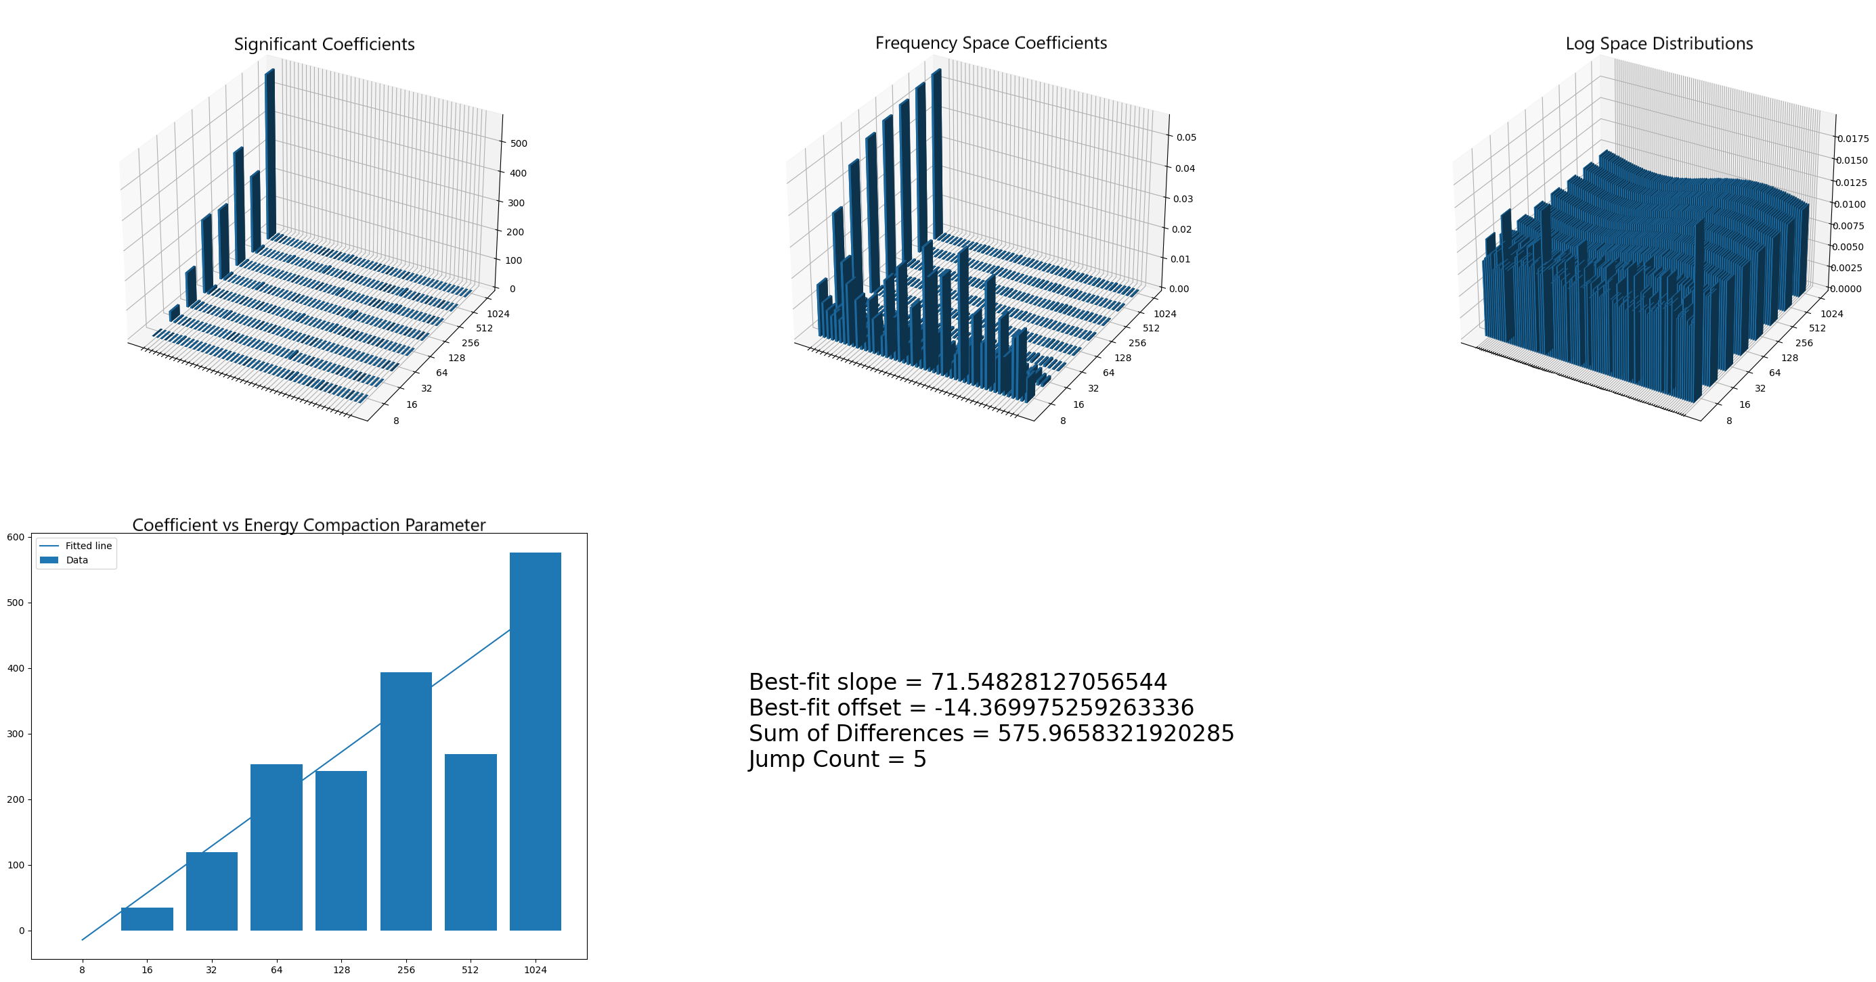
Examples- Edited

Slide 28
Examples
Unedited Original
Edited
Please see the accompanying demonstration video for additional examples and a more detailed process description

Slide 29
Use cases - Customers
Legal - confidence in evidentiary imaging as legitimate
Insurance – confidence in establishing the facts of a claim
Government – confidence in the provenance of intelligence
Social Media – trust in shared images…loss of Section 230 indemnity?
Journalism – confidence and indemnity for image provenance
Access Security – confidence that biometric data is valid

Slide 30
Why now?
Increased frequency of digital image manipulation coupled with growing reliance on this same data creates a vulnerability that lacks an effective market solution
Current competitors in the marketplace do not address the issue as effectively or comprehensively as we can
Ex- Reality Defender utilizes a 100% AI/ML model approach to identify deepfakes. This limits use case applications and provides barriers for evidentiary use. In addition, the technology, at the base level is consistently behind the potential exploit curve.
Previous (non-AI/ML based) attempts to address the problem were time consuming, limited, and/or utilized self-obsolescing technology
Our Patent Pending process is not subject to these limitations

Slide 31
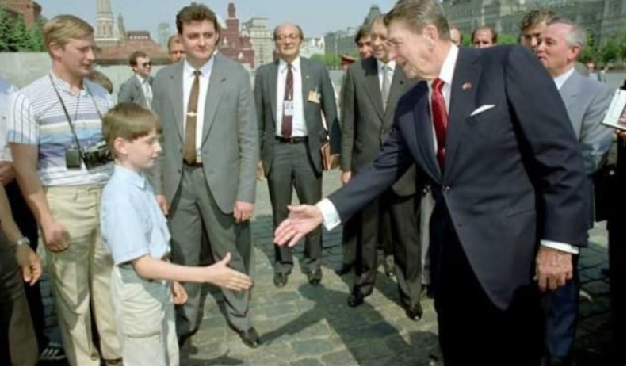
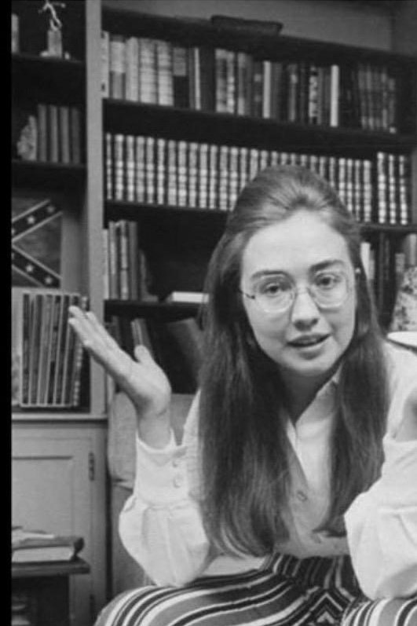
Why Now? Potential Impact

Slide 32
Market Dimension Examples
Insurance
Fraud Detection Market CAGR: 24.2% -> 2031 - $3.3B in 2021
Solution Segment CAGR: 27.8% -> 2031
Social Media
Content Creation CAGR: 14.5% -> 2032 - $5.7B in 2022
Automatic Content Recognition CAGR: 17.4% -> 2026 – $1.59B in 2020
Media Management CAGR: 24.3% -> 2028
Legal
Legal Services CAGR: 5.3% -> 2030 - $901.8B in 2021
Legal Case Mgmt Software CAGR: 12.4% -> 2028 - $786M in 2021
Biometric Access Control
Biometric Systems Market CAGR: 13.4% -> 2030 – $39.95B in 2021
Biometrics Market CAGR: 15.2% -> 2026 - $27.09B in 2020

Slide 33
return strategies
B2B – e.g., Twitter uses our SaaS offering to place a blue checkmark on images in their content
Licensing - e.g., the United States government pays a license fee each time they use our technology to validate an image
B2C – Individuals use the SaaS offering to establish trust in images they’re working with
Acquisition event - e.g., Apple acquires our technology and uses it to add trust to their images
Example:
350M+ images uploaded to Facebook daily
Assume our verification process is utilized for 1% of the images @ $.01 each
$12.8M in annual revenue

Slide 34
Return Strategies
Actual market impact is almost incalculable at this point due to the novel nature of the technology
Our solution could democratize the difficult and expensive field of image and video forensics
A simple click of the mouse
Automated analysis at time of intake
Consider Aluminum
Once was considered a precious metal
Now products like aluminum cans are ubiquitous

Slide 35
What we bring to the table- Traction
Revolutionary Patent Pending Technology
Assembled The Right Team
World class experts
Long term relationships and track record for collaboration
Dedicated with demonstrated ability to work as a team and achieve objectives
Capability
Current state technology is effective for a majority of images on the market
2022
Pitch Deck
35

Slide 36
Why we need money
To refine our machine learning (AI) models to aid analysis and expand use case functionality for edge cases
To sharpen our analysis with a deeper understanding of the behavior of the data
To produce market ready product
To evaluate and create distribution channels
2022
Pitch Deck
36

Slide 37
Year One – Digital Images
Develop and refine technology
Complete the next phase of development to refine the technology and tune it for the selected use cases
Complete marketable Products
Complete application refinement and produce marketable products for launch
Establish Delivery mechanisms
Prepare technological backbone supporting the various delivery mechanisms sought by the end consumers

Slide 38
Year One – Breakdown
Fully Develop AI Models
Hire AI/Machine Learning Engineer
Refine parameters and train models on sample data
Refine Decision Engine
Incorporate decision engine into the code base
Integrate AI
Prepare final product for launch
Package application with UI/UX addressing selected market customer base
Create market/customer specific delivery backbone – Ensure scalability

Slide 39
Year 2
Market & revenue growth
Hire sales staff & aggressively market product in selected use cases
Begin transition to a revenue-based model
Expand & increase Product Launch
Continue development to address new still image use case segments
Launch product for additional target markets
Bridging revenue opportunities
Proven world class consultancy experience and customer base
Development and launch of a verified ecosystem
Software application for maintaining the history and provenance of digital assets
Application utilizes components of the primary product line

Slide 40
Years One & Two
Month 10:
AI models completed & incorporated into decision engine
Month 12:
Beta launch with identified partners
Month 18:
Product launch in two use cases
Month 19:
Begin shift to revenue based model
Month 1:
Seed Funding Received
Month 24:
Receive series A funding
Month 20:
Begin soliciting series A funding

Slide 41
Year 3
Continued Market & revenue growth
Continue to aggressively market product in additional use cases
Develop Video & Audio capabilities
Leverage existing methodology & refine for video/audio applications
Port technology into platform and launch in relevant use cases

Slide 42
The patent
Utilized Faegre Drinker Biddle & Reath LLP to develop a comprehensive intellectual property management strategy
Initial Patent filing is completed
Additional Patent filings will be completed as development progresses

Slide 43
Financials
Budget, funding request, runway, and timeline for transition to a revenue based model are available upon request
For additional information, contact us at:
Jason.Harvey@Vidatis.com

Slide 44
In this world, wouldn’t it be nice if we could all make money off the truth for a change?

